Slide 1
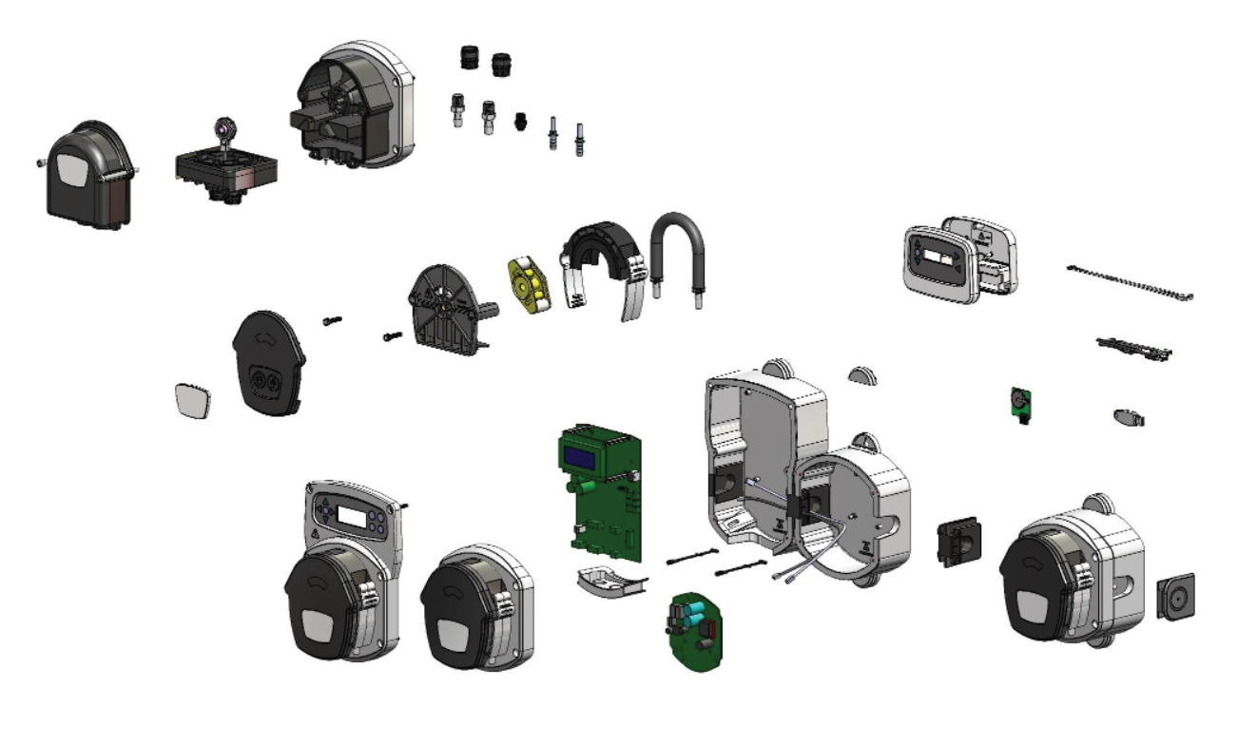
10
18
19
20
14
17
23
24
11
9
12
1
3
8
13
2
22
15
5
21
4
6
7
Brightlogic High Flow & Membrane Pump Spares Diagram
16
M0249 Issue 2.3

Slide 2
Item | Description | Spares Code
1 | BRIGHTLOGIC HIGH FLOW ENCLOSURE | XSB052
2 | BRIGHTLOGIC HF PUMP ENCLOSURE | XSB054
3 | BRIGHTLOGIC SCREW COVERS -10PK | XSB060
4 | BRIGHTLOGIC END WEDGES – 10PK | XSB061
5 | BRIGHTLOGIC LINK WEDGES – 10PK | XSB062
 | FR BRIGHTLOGIC LINK WEDGES -10PK | XSB062/FR
6 | BRIGHTLOGIC HINGE STRAP -10PK | XSB063
7 | BRIGHTLOGIC CABLE ENTRY (HF) | XSB065
8 | BRIGHTLOGIC HF PUMP ROTOR – 10PK | XSB120
9 | BRIGHTLOGIC HF PUMP BODY -5PK | XSB201
10 | MEMBRANE PUMP COVER & BACKPLATE | XSB735
11 | HF PUMP RACE & CLIPS | XSB206
12 | L PUMPHEAD SCREW (SPH) | XSB207
13 | BRIGHTLOGIC PLAQUE X10 | XSB211
 | BRIGHTLOGIC PLAQUE 160PK – 1 COLOUR LOGO | XSB214
 | BRIGHTLOGIC PLAQUE 160PK – 2 COLOUR LOGO | XSB215
T +44 (0)1273 513 566 E sales@brightwell.co.uk W brightwell.co.uk

Slide 3
Item | Description | Spares Code
14 | TUBE : HF G-SIL : 10PK | XSB333
 | TUBE : HF G-SIL : 10PK | XSB333Q
 | TUBE : HF G-SIL : 50PK | XSB334
 | TUBE : HF G-SIL : 50PK | XSB334Q
 | TUBE : HF B/CHEM : 2PK | XSB370
 | TUBE : HF B/CHEM : 10PK | XSB373
 | TUBE : HF B/CHEM : 10PK | XSB373Q
 | TUBE : HF B/CHEM : 50PK | XSB374
 | TUBE : HF B/CHEM : 50PK | XSB374Q
15 | BRIGHTLOGIC LAUNDRY BOARD | XSB019
16 | BRIGHTLOGIC ADD-ON BOARD | XSB020
17 | FORMULA SELECT COVER & MEMBRANE | XSB069
18 | PVDF BSP IN&OUT EPDM PURPLE 5PK | XSB731
 | PVDF NPT IN&OUT EPDM PURPLE 5PK | XSB732
 | BSP IN&OUT EXT VIT RED 5PK | XSB733
 | NPT IN&OUT EXT VIT YELLOW 5PK | XSB734
T +44 (0)1273 513 566 E sales@brightwell.co.uk W brightwell.co.uk

Slide 4
Item | Description | Spares Code
19 | MEMBRANE CLAMP ASSEMBLY 3/8 BSP | XSB721
 | MEMBRANE CLAMP ASSEMBLY 3/8 NPT | XSB722
 | CLAMP PLATE ASSEMBLY BSP PVDF | XSB727
 | CLAMP PLATE ASSEMBLY NPT PVDF | XSB728
 | CLAMP PLATE ASSEMBLY BPS PP | XSB729
 | CLAMP PLATE ASSEMBLY NPT PP | XSB730
20 | ¼ STRAIGHT – 6MM BARBED TUBE CONNECTOR (BLACK) 10 | XSB727
 | ¼ STRAIGHT – 8MM BARBED TUBE CONNECTOR (BLACK) 10 | XSB728
 | 3/8 STRAIGHT – 10MM BARBED TUBE CONNECTOR (BLACK) 10 | XSB729
 | 3/8 STRAIGHT – 3/8 BARBED TUBE CONNECTOR (WHITE) 10 | XSB730
21 | HF ADD-ON LID ASSEMBLY | XSB107
22 | LOGIC HF CONTROL LID ASSEMBLY | XSB106
23 | 8MM BARBED CONNECTOR 3/8 FIT 10PK | XSB740
 | 10MM BARBED CONNECTOR 3/8 FIT 10PK | XSB718
 | 12MM BARBED CONNECTOR 3/8 FIT 10PK | XSB719
24 | 3/8 QUICK COUPLINE 10PK | XSB720
T +44 (0)1273 513 566 E sales@brightwell.co.uk W brightwell.co.uk

